Slide 1



What is Sparx Reader?
Your child will be completing weekly reading homework using Sparx Reader.
Sparx Reader is designed to help every student do meaningful, independent reading every week, which is vital for building reading stamina, improving literacy skills, and promoting perseverance.
It’s really important that young people are able to practise careful, silent reading for a decent amount of time, without distraction.
Sparx Reader reassures teachers and parents that focused reading is happening, and that readers of all abilities feel successful and motivated.

Slide 2
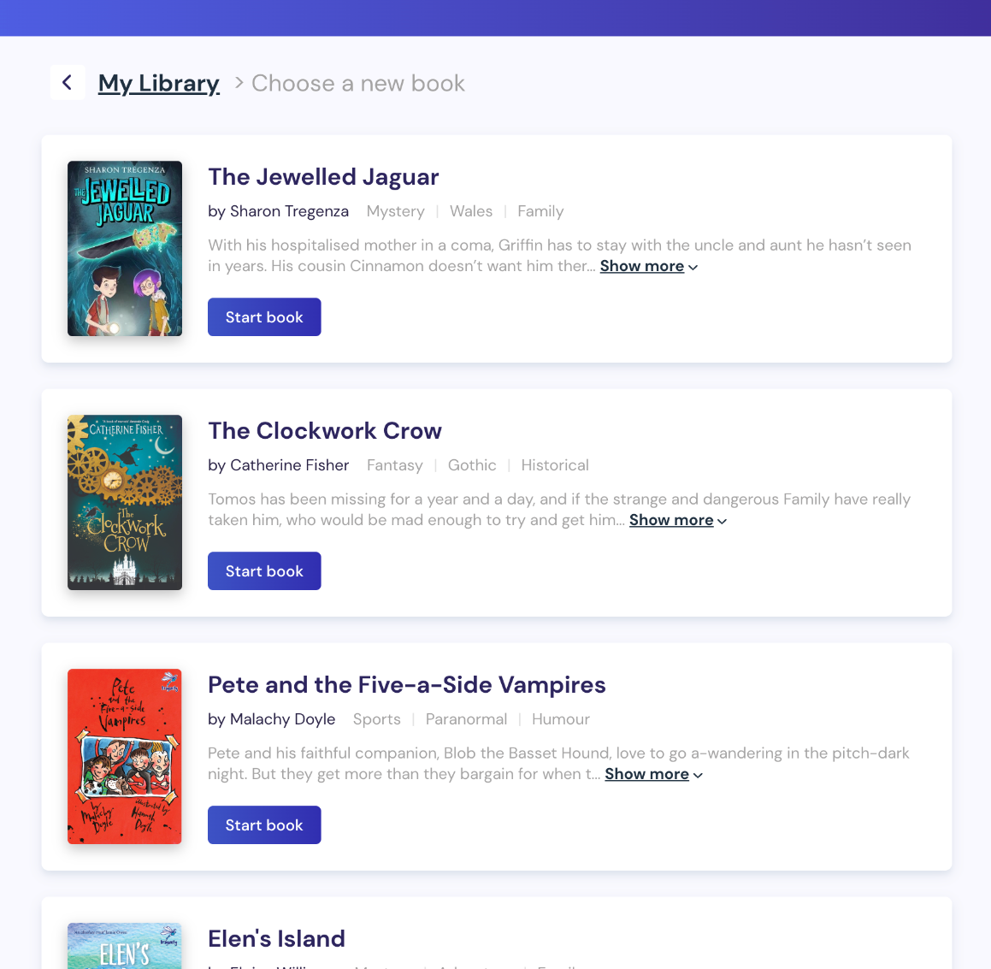
How does Sparx Reader work?
Students can choose from an appropriate range of ebooks at their reading level and as they read, they’ll answer questions to check they’re reading carefully.
Careful readers earn points, meaning they can prove they’ve been focusing and ultimately climb the league table!
Once students have answered the questions correctly, they will then earn some Sparx Reader Points (SRP), which count towards their homework task.

Slide 3
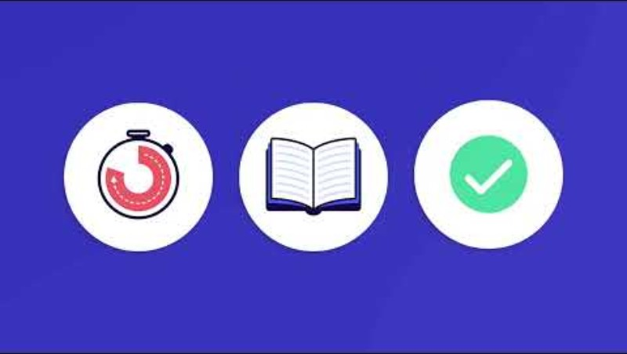
How does Sparx Reader work?
This video explains what
Sparx Reader is and how it works

Slide 4
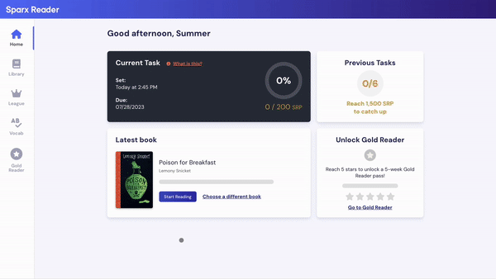
What does reading look like on Sparx Reader?
This video shows an example of what reading on Sparx Reader looks like.
Sparx Reader ensures pupils are given books at their reading level.

Slide 5


What do the questions look like on Sparx Reader?
The questions are quick and simple to answer if the section has been read properly, but aren’t easy to guess if the section has been skimmed or not read at all.
The questions only focus on the main parts of the story, that a reader should naturally remember if they are going to be able to follow the whole book’s events.
This is why pupils must focus on reading slowly and carefully.

Slide 6

Why is the text removed before the questions come up on Sparx Reader?
We remove the section that has just been read before students are asked questions about it.
We want to train our young people to slow down and read really carefully.
We don’t want our readers to check the questions before reading the section, because that leads to an unnatural and disconnected reading experience where they’re scanning for the answers instead of concentrating on, and enjoying, the story.

Slide 7
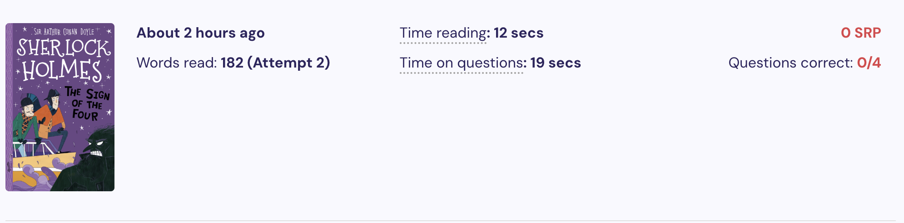
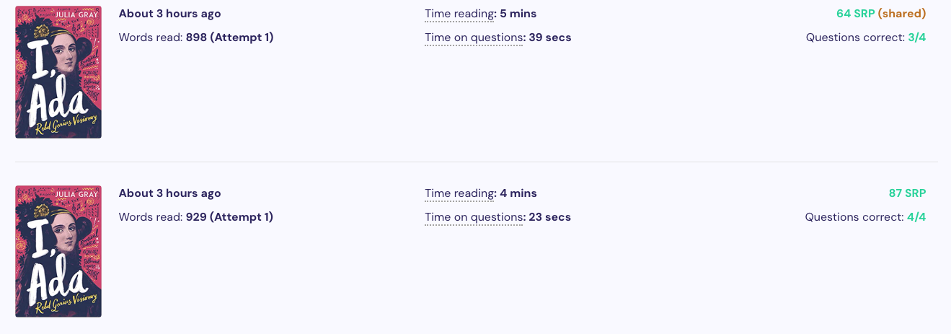
How can a teacher help my child on Sparx Reader?
Teachers can see each student’s reading activity on Sparx Reader.
This means they can see where a student might be struggling with the reading and the questions, and offer them support.

Slide 8
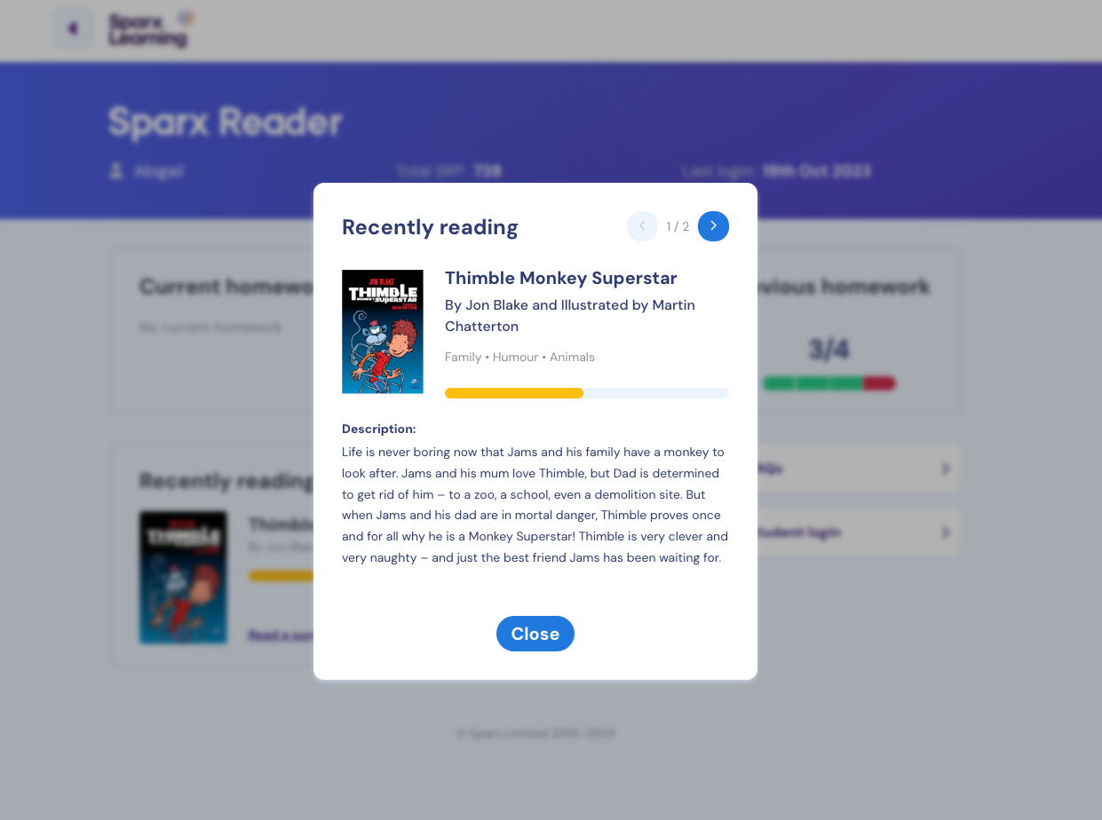
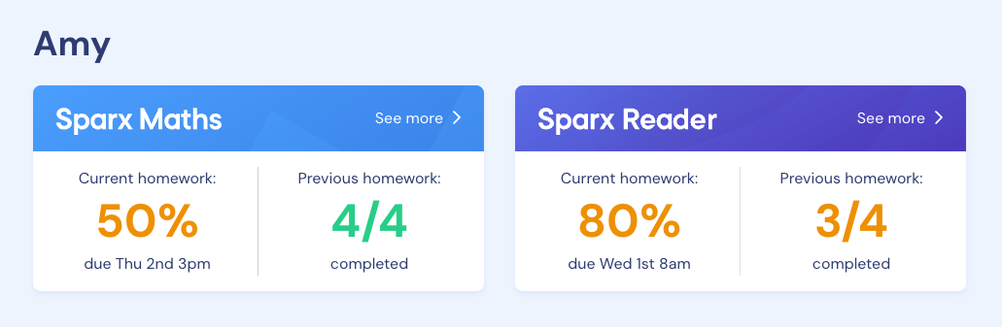
How can you see what your child is reading on Sparx Reader?
You are able to see how your child is getting on with their reading using the link to the Parent Portal, available in your weekly Sparx Maths homework emails.
When clicking through the link, you will be able to keep track of any Sparx system that your child uses.
Here you can keep track of previous homeworks as well as the book your child is currently reading.

Slide 9
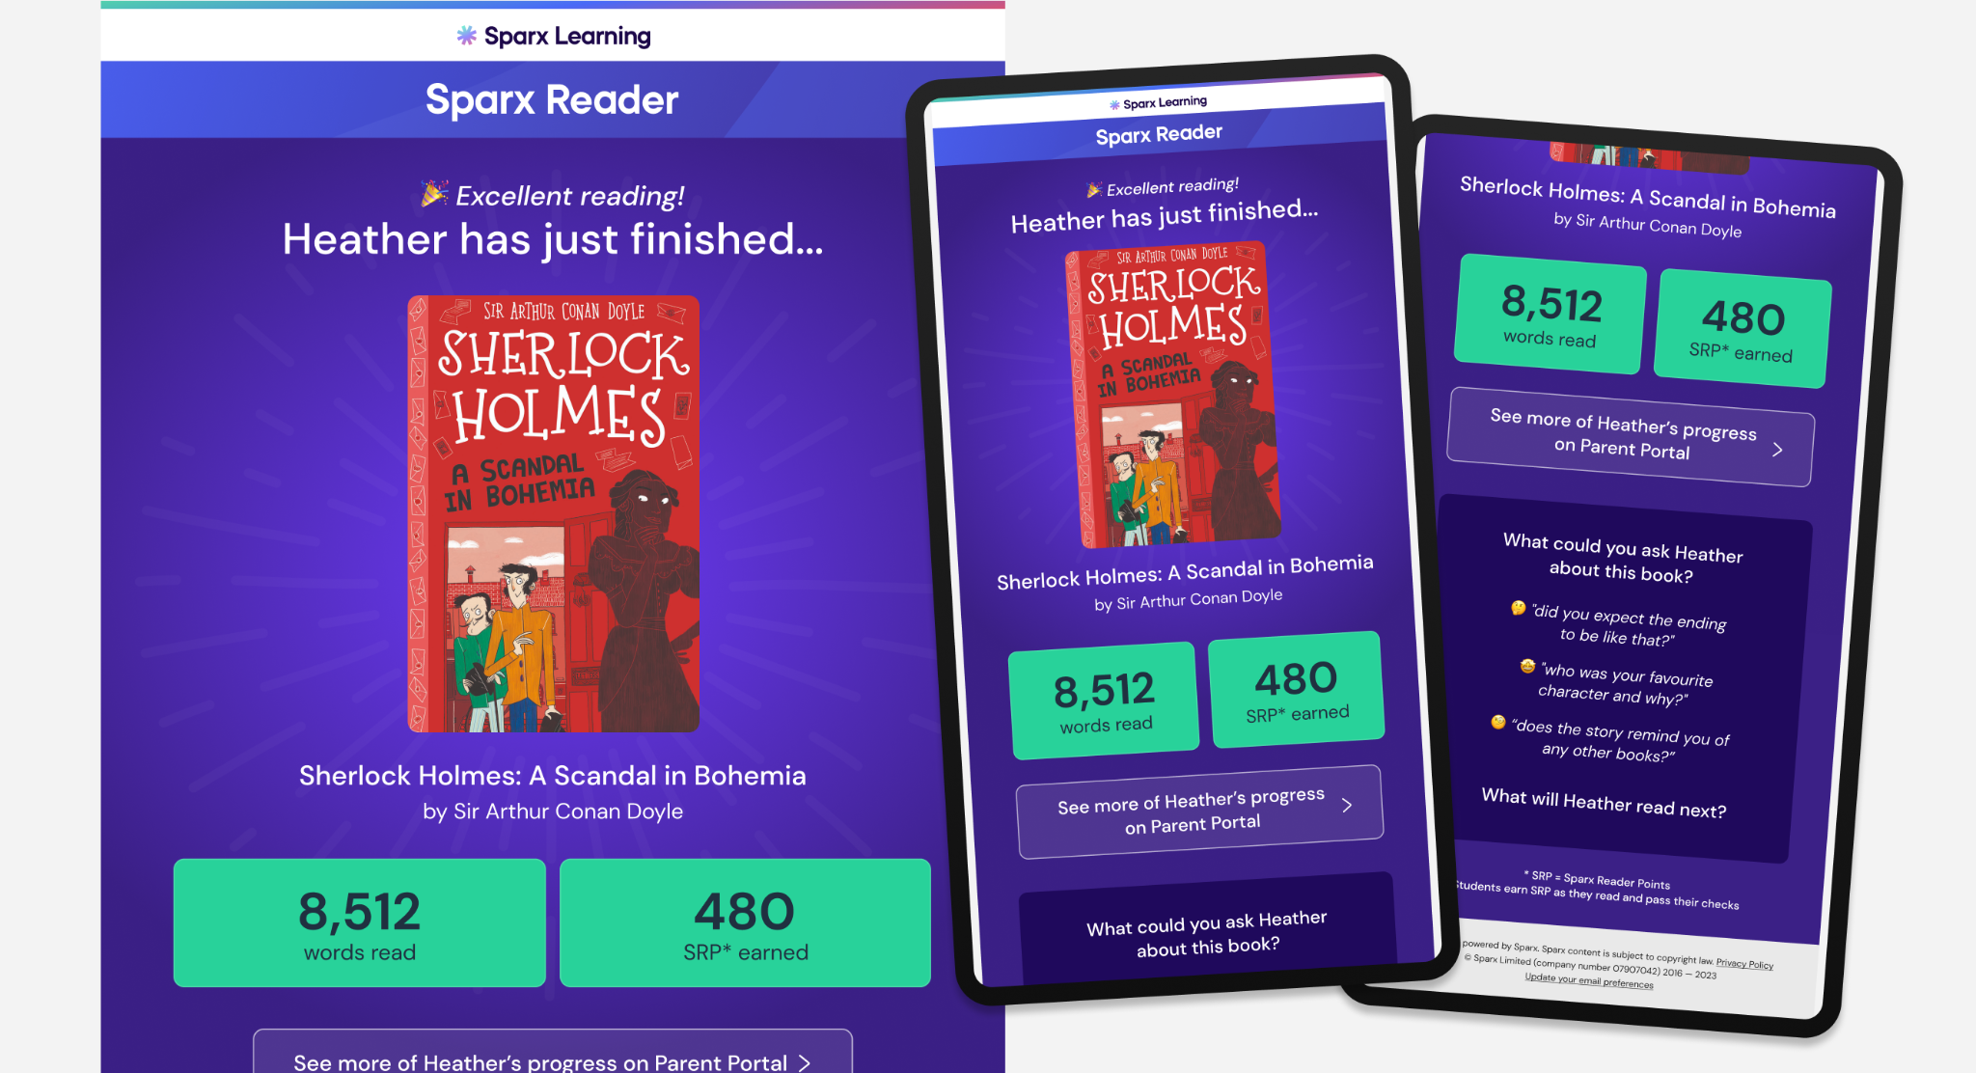
Sparx Reader will email you when your child completes a book

Slide 10
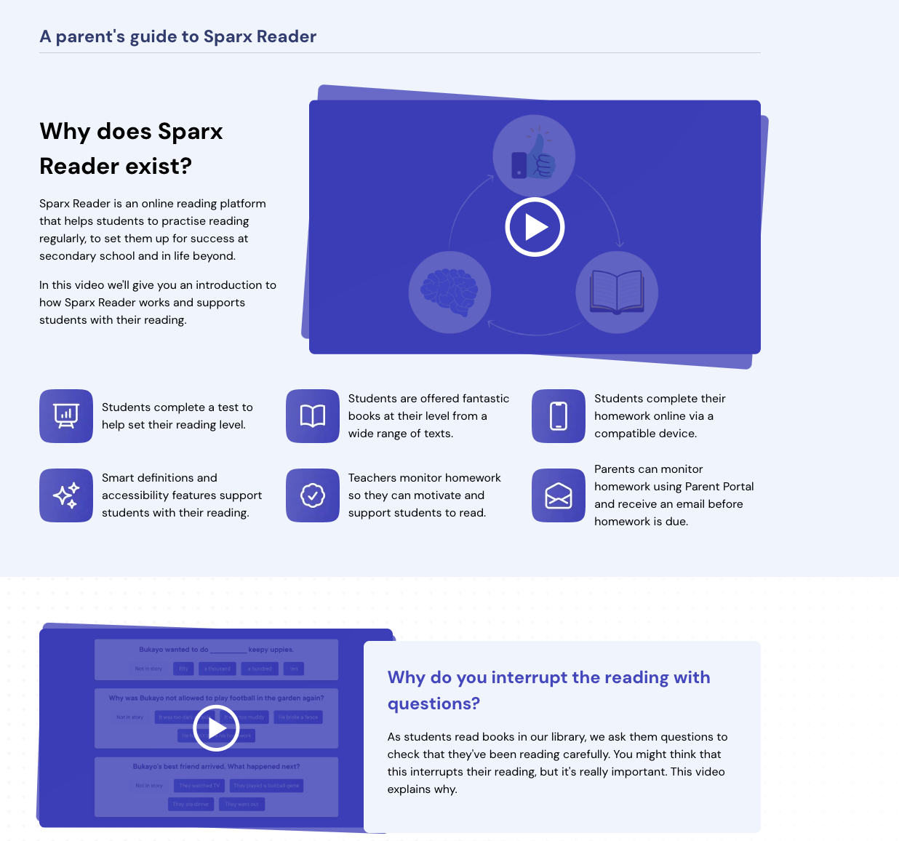
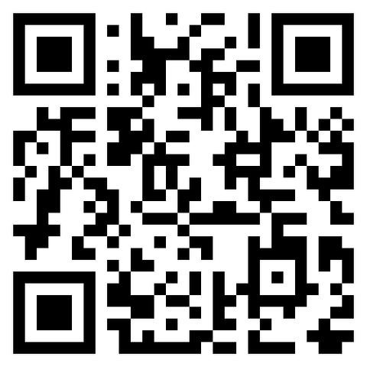
How can you access more information about Sparx Reader?
Visit our website for a series of brief videos that explain how and why Sparx Reader works in the way that it does.
This QR code will take you to the parent video page:
https://sparxreader.com/parents/

Slide 11
Sparx Reader FAQs
How do they log in?
Students log in at https://reader.sparx-learning.com/. They will need to find their school and log in using their Sparx login details.
What devices are supported?
Your child can access Sparx Reader on any device that connects to the internet with a web browser.
How can I support my child with their reading?
Sparx Reader adapts to each student’s reading level, so it’s important that you don’t help by answering questions for them. If you help them, Sparx Reader might think they’re a very strong reader and show them books that are too difficult.
You can help by providing a quiet space for your child to focus on their reading homework each week and encourage them to read carefully.
If your child doesn’t like a book, encourage them to keep trying! If they still don’t get on with it, they can give the book a low rating and they’ll be able to swap to another book.
The best way to support your child is to ask them about the book they’re reading; what aspects they’re enjoying, or what characters and events they’ve recently read about.

